Slide 1


AI DRIVEN ENGINEERING REVIEW – 1 Real-Time E-Commerce User Analytics and Recommendation System
Team No- 13
Roll No Name
Krithik Reddy 2320030234
Karthikeya 2320030501
Sai Bharadwaj 2320030482
Department of Computer Science and Engineering
KONERU LAKSHMAIAH EDUCATION FOUNDATION

Slide 2
OUTLINE
• Abstract
• Introduction
• Objectives
• Literature Survey
• Implementation
• Conclusion
• References

Slide 3
Abstract
In modern e-commerce platforms, massive volumes of user activity data such as clicks, purchases, and browsing events are generated continuously. Traditional systems are unable to efficiently process this high-volume and high-velocity data in real time. This project presents a Real-Time E-Commerce User Analytics Dashboard using Big Data technologies such as Apache Kafka and Apache Spark. The system ingests streaming user events, processes them in a distributed environment, and integrates demographic data to generate meaningful insights. Processed metrics are stored in a time-series database and visualized through interactive dashboards. The proposed solution demonstrates scalable, fault-tolerant, and real-time data processing to support data-driven decision-making in e-commerce environments.

Slide 4
Introduction
In today’s digital world, e-commerce platforms like Amazon and Flipkart generate massive amounts of user activity data every second. Users continuously click products, browse categories, add items to carts, and complete purchases. Managing and analyzing this large-scale, high-speed data has become a major challenge. Traditional systems are not capable of processing such high-volume and high-velocity data in real time, which limits businesses from gaining immediate insights into customer behavior and campaign performance.
This project proposes a Real-Time E-Commerce User Analytics Dashboard using Big Data technologies like Apache Kafka and Apache Spark. The system processes streaming data in a distributed environment and provides live insights through dashboards, enabling faster and data-driven business decisions.

Slide 5
Objectives
To design a real-time data pipeline for e-commerce user activity.
To collect and process high-volume streaming data using Apache Kafka.
To implement distributed data processing using Apache Spark.
To integrate streaming data with structured demographic data.
To use ML Algorithms for analytics.
To build an interactive dashboard for real-time visualization.

Slide 6
Proposed Method
Data Ingestion: User events such as clicks and purchases are streamed in real time using Apache Kafka.
Data Integration: Streaming event data is combined with user demographic data stored in MySQL.
Machine Learning Models
Logistic Regression → Predict purchase probability
K-Means → Customer segmentation
Anomaly Detection → Detect unusual activity
Storage: Processed metrics are stored in InfluxDB, a time-series database optimized for real-time analytics.
Visualization: Data is displayed through Grafana dashboards to provide live insights into sales, campaign performance, and user behavior.

Slide 7
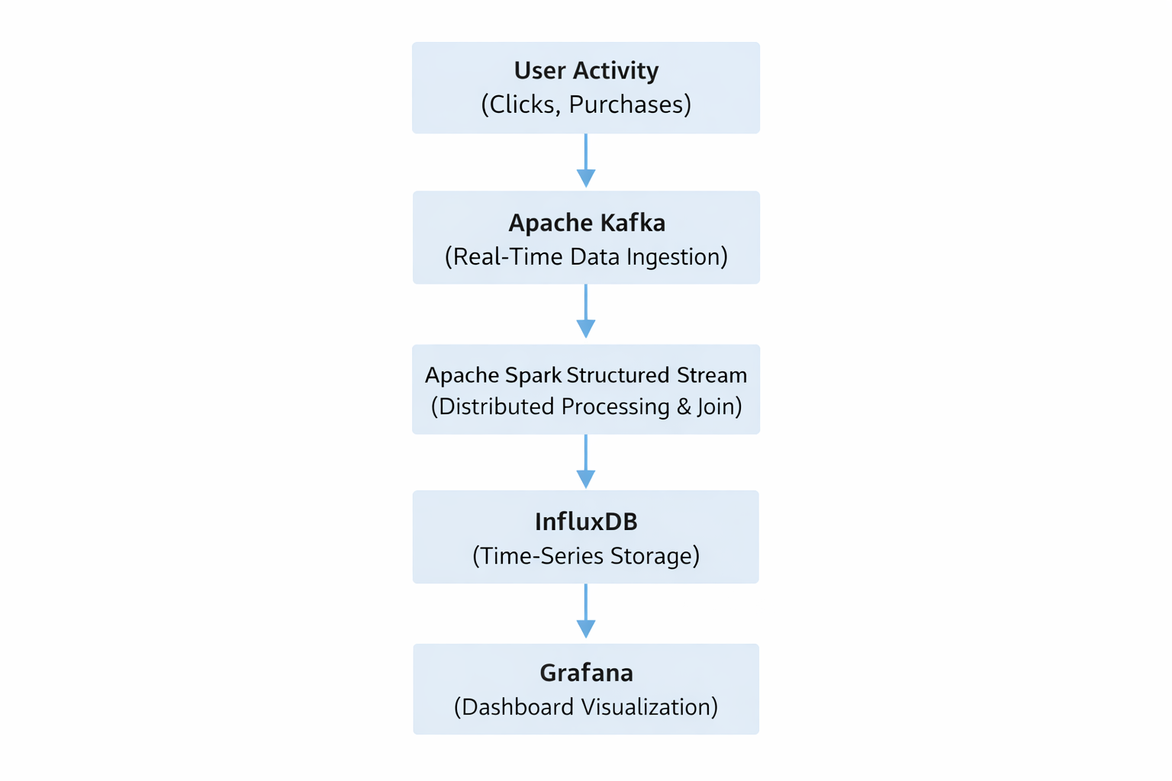
System Architecture (Block Diagram)

Slide 8
Literature Survey
Paper Link | Author Name | Journal/Conference | Drawbacks / Future Scope
LINK | Sabina-Cristiana Necula | AI-Driven Recommendations: | Some proposed models require high memory and processing power, making them expensive for practical implementation.
LINK | Xia Song, Shiqi Yang, Ziqing Huang and Tao Huang | The Application of Artificial Intelligence in Electronic Commerce | Older survey; needs updates with deep learning and big data frameworks
LINK | Samuel Fosso Wamba | Big data analytics in E-commerce | Many studies assume clean data and do not handle missing, noisy, or inconsistent real-world data.
LINK | A.A. Nimbalkar and A.T. Berad | THE INCREASING IMPORTANCE OF AI APPLICATIONS IN E-COMMERCE | Research is often tested on a single dataset, which may not represent real-world data variety.
LINK | Xue Song | User-Centric Internal Tools in E-commerce: | Uses R for sentiment analysis; doesn’t cover big data frameworks like Spark/Hadoop.

Slide 9
Implementation
Tools Used:
Apache Spark Structured Streaming
Spark MLlib
MySQL
InfluxDB
Grafana
Apache Kafka
Docker Compose
Avro (Data Format)

Slide 10
Conclusion
In this project, we designed a Real-Time E-Commerce User Analytics Dashboard using Big Data technologies. The system collects high-volume streaming data using Apache Kafka and processes it in a distributed manner using Apache Spark. By integrating streaming and structured data, the platform provides real-time insights through interactive dashboards.

Slide 11
References
Änäkkälä, T. (2021). Exploring value in eCommerce artificial intelligence and recommendation systems.
2. Builtin.com. (2021). What is Artificial Intelligence? How Does AI Work? | Built In. Retrieved from https://builtin.com /artificial-intelligence
3. Kumar, T., & Trakru, M. (2020). The Colossal Impact of Artificial Intelligence.

Slide 12
THANK YOU

